Slide 1
Retrieval Augmented Generation

Slide 2
Agenda
Structural Diagram
Building Blocks Explanation

Slide 3
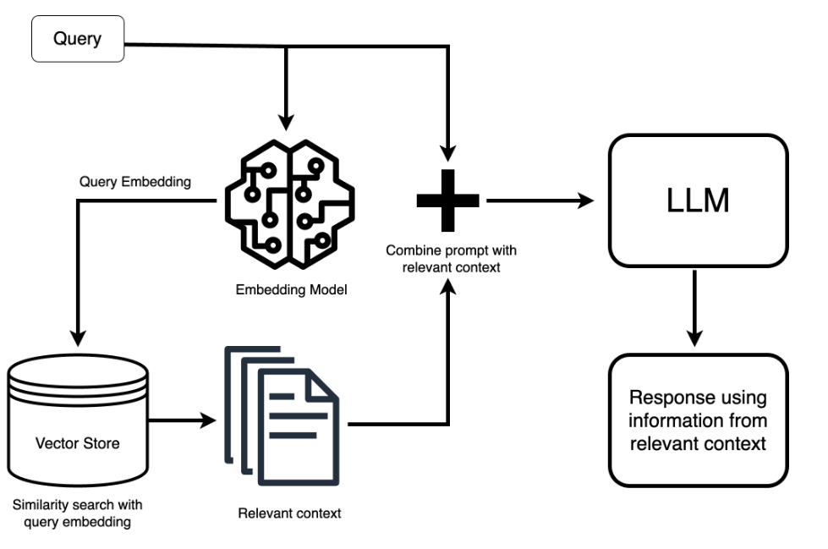
Structural representation

Slide 4
Explanation of each block
Querying: When you want to ask an LLM a question it may not have the answer to, you start by giving it a prompt, such as “What’s the latest development in AI legislation?”
Retrieval: This prompt goes through an embedding model and transforms into a vector itself—it's like it’s getting its own search terms based on its meaning and not just identical matches to its keywords. The system then uses this search term to scour the vector database for the most relevant chunks related to your question.
Prepending the Context: The most relevant chunks are then served up as context. It’s similar to handing over reference material before asking your question, except we give the LLM a directive: “Using this information, answer the following question.” While the prompt to the LLM gets extended with a lot of this background information, you as a user don’t see any of this. The complexity is handled behind the scenes.
Answer Generation: Finally, equipped with this newfound information, the LLM generates a response that ties in the data it’s just retrieved, answering your question in a way that feels like it knew the answer all along.

